Slide 1
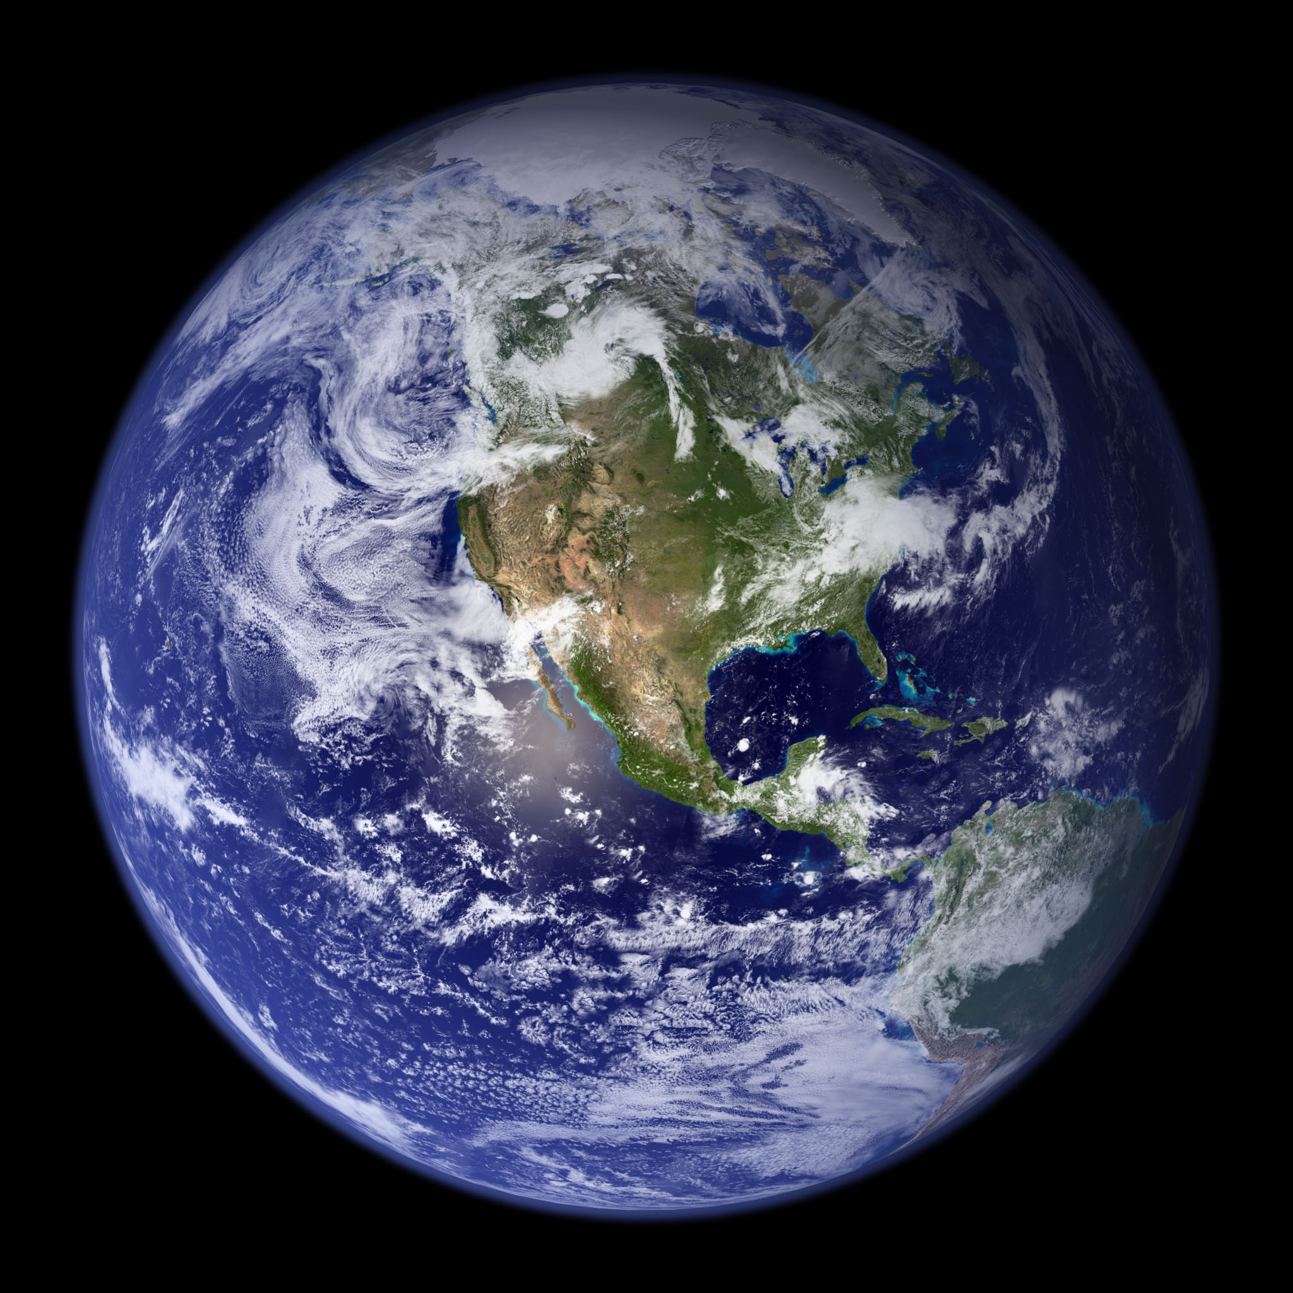
Week 11
Synthesis:
Climate Feedbacks
Anthropogenic Climate Change
Notes:
4:01 long

Slide 2
Required Reading:
Donnadieu et al. (2004): “A ‘snowball Earth’ climate triggered by continental break-up through changes in runoff”
First five pages of Build Your Own Earth exercises assignment
Optional Assignment:
BuildYourOwnEarth exercises
Optional Reading:
A Walk Through Climate History
Introduction to Climate Science
Paleogeographic controls on climate and proxy interpretation
How Proxy Data reveals the climate of the Earth’s distant past

Slide 3
Today
Questions from last week or videos
Weather recap and forecast
Examples of feedbacks in the climate system
Implications for climate change in field geology
Anthropogenic climate change affects all components of the climate system
Final exam
25-Question Kahoot!

Slide 4
Weather recap and forecast

Slide 5
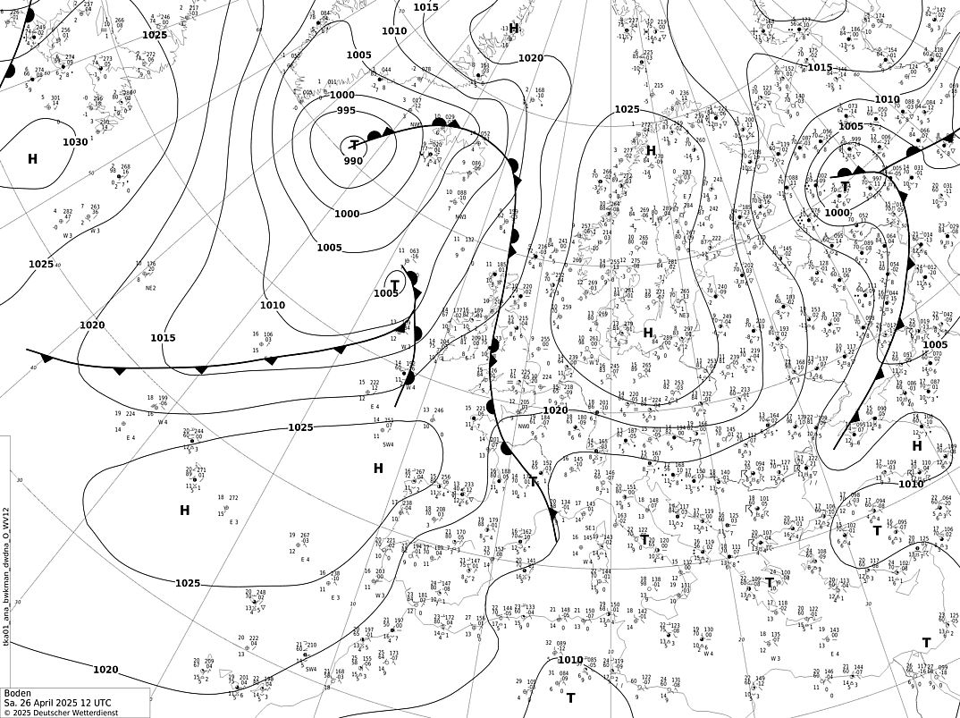
https://www.wetter3.de/archiv_dwd_dt.html
L
L
L
H
H
1200 UTC Sat 26 April

Slide 6
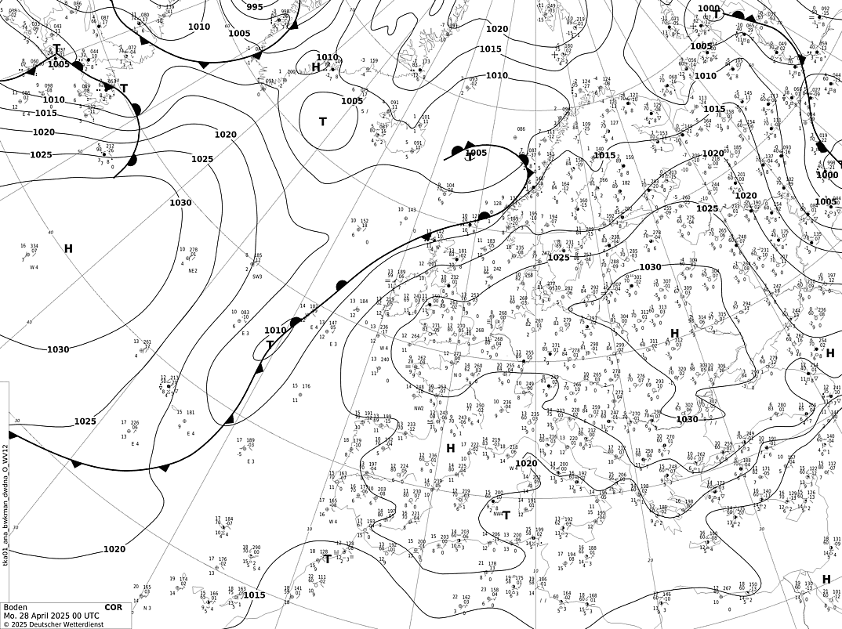
https://www.wetter3.de/archiv_dwd_dt.html
L
L
H
cool
warm
L
H
0000 UTC Mon 28 April

Slide 7
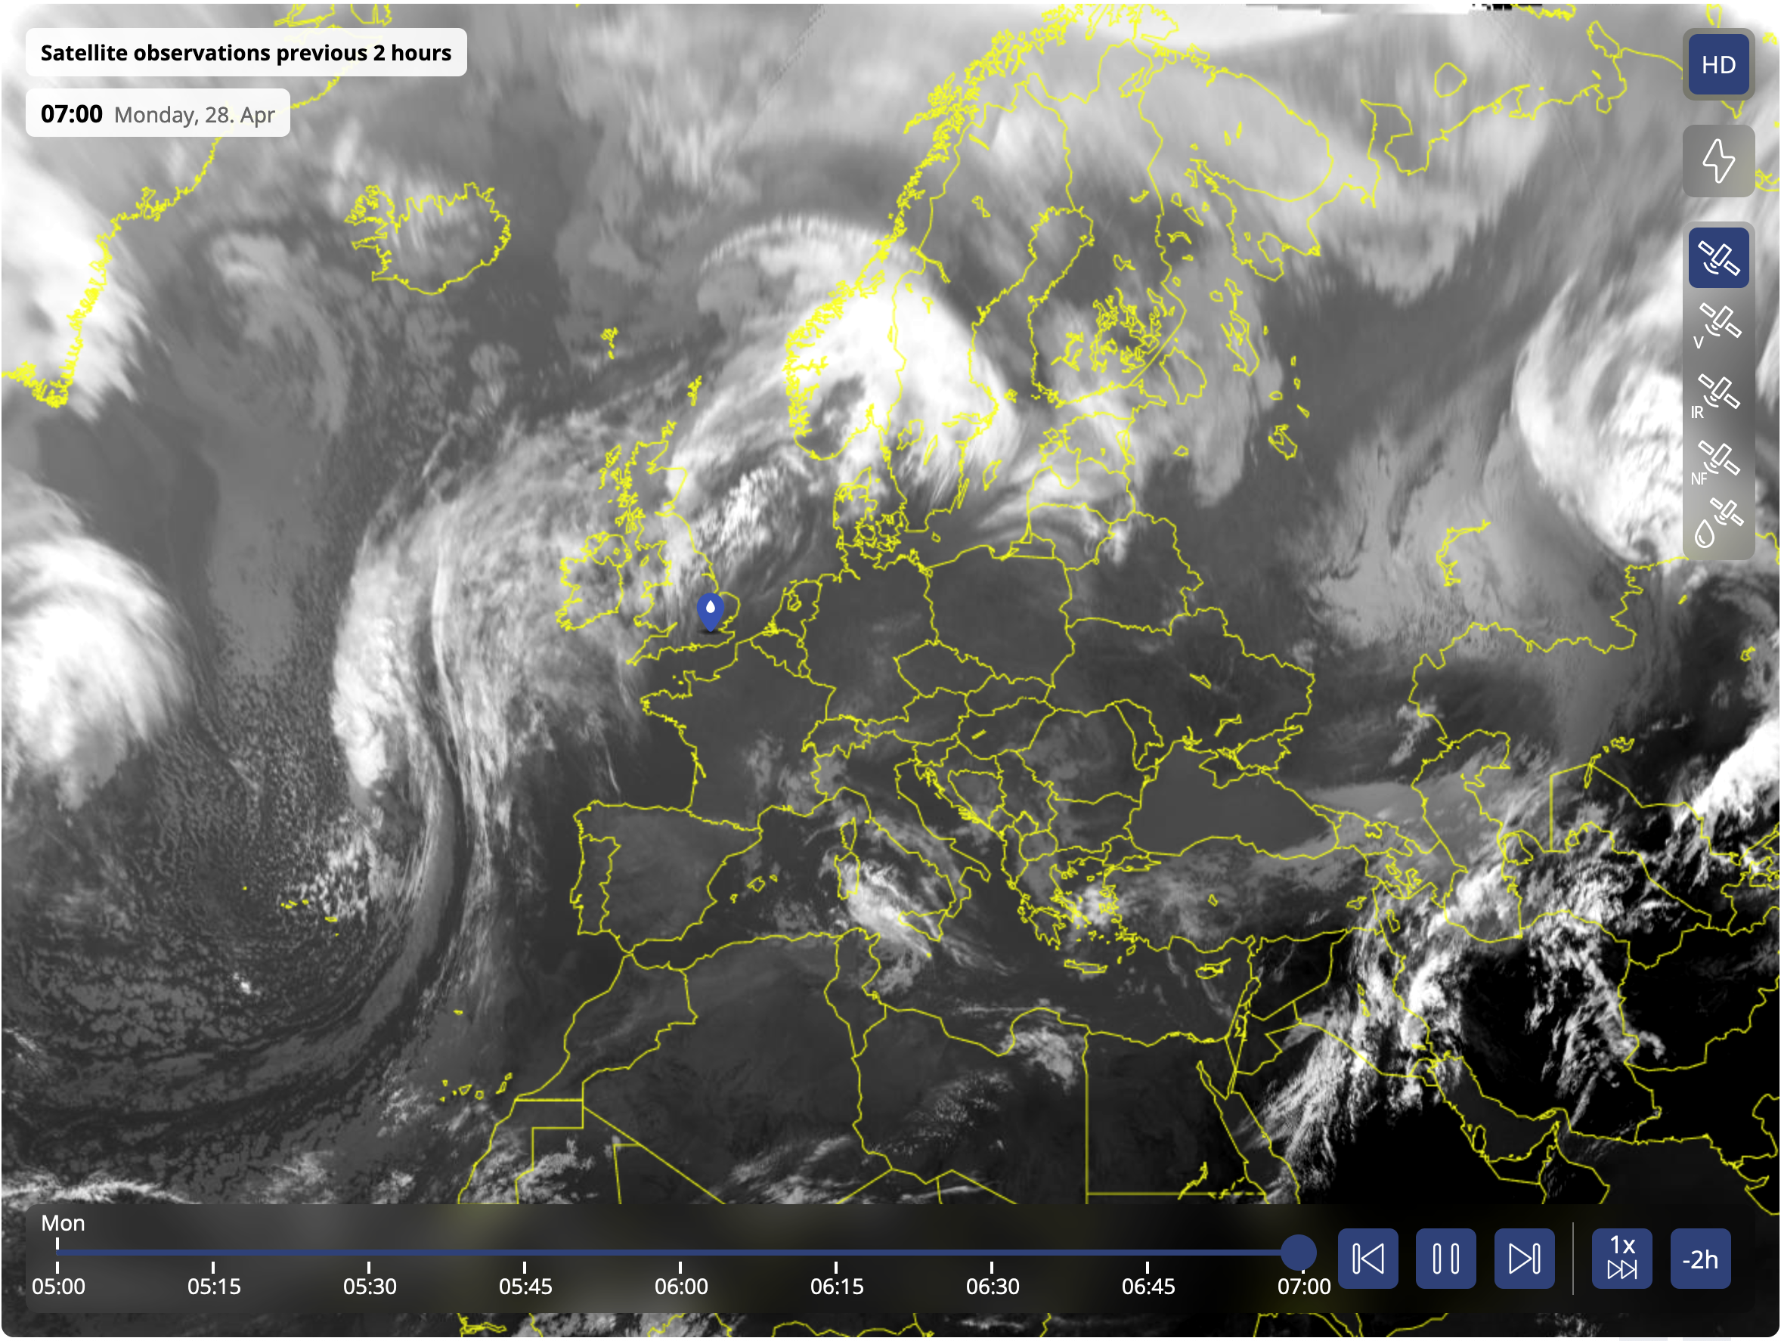
no/low clouds
(high pressure)
comma
(low pressure)
infrared
https://www.sat24.com/en-gb/continent/eu/hd

Slide 8
no/low clouds
(high pressure)
comma
(low pressure)
L
L
H
infrared
https://www.sat24.com/en-gb/continent/eu/hd

Slide 9
Animation of the infrared satellite imagery
https://www.sat24.com/en-gb/continent/eu/hd#selectedLayer=satDay

Slide 10
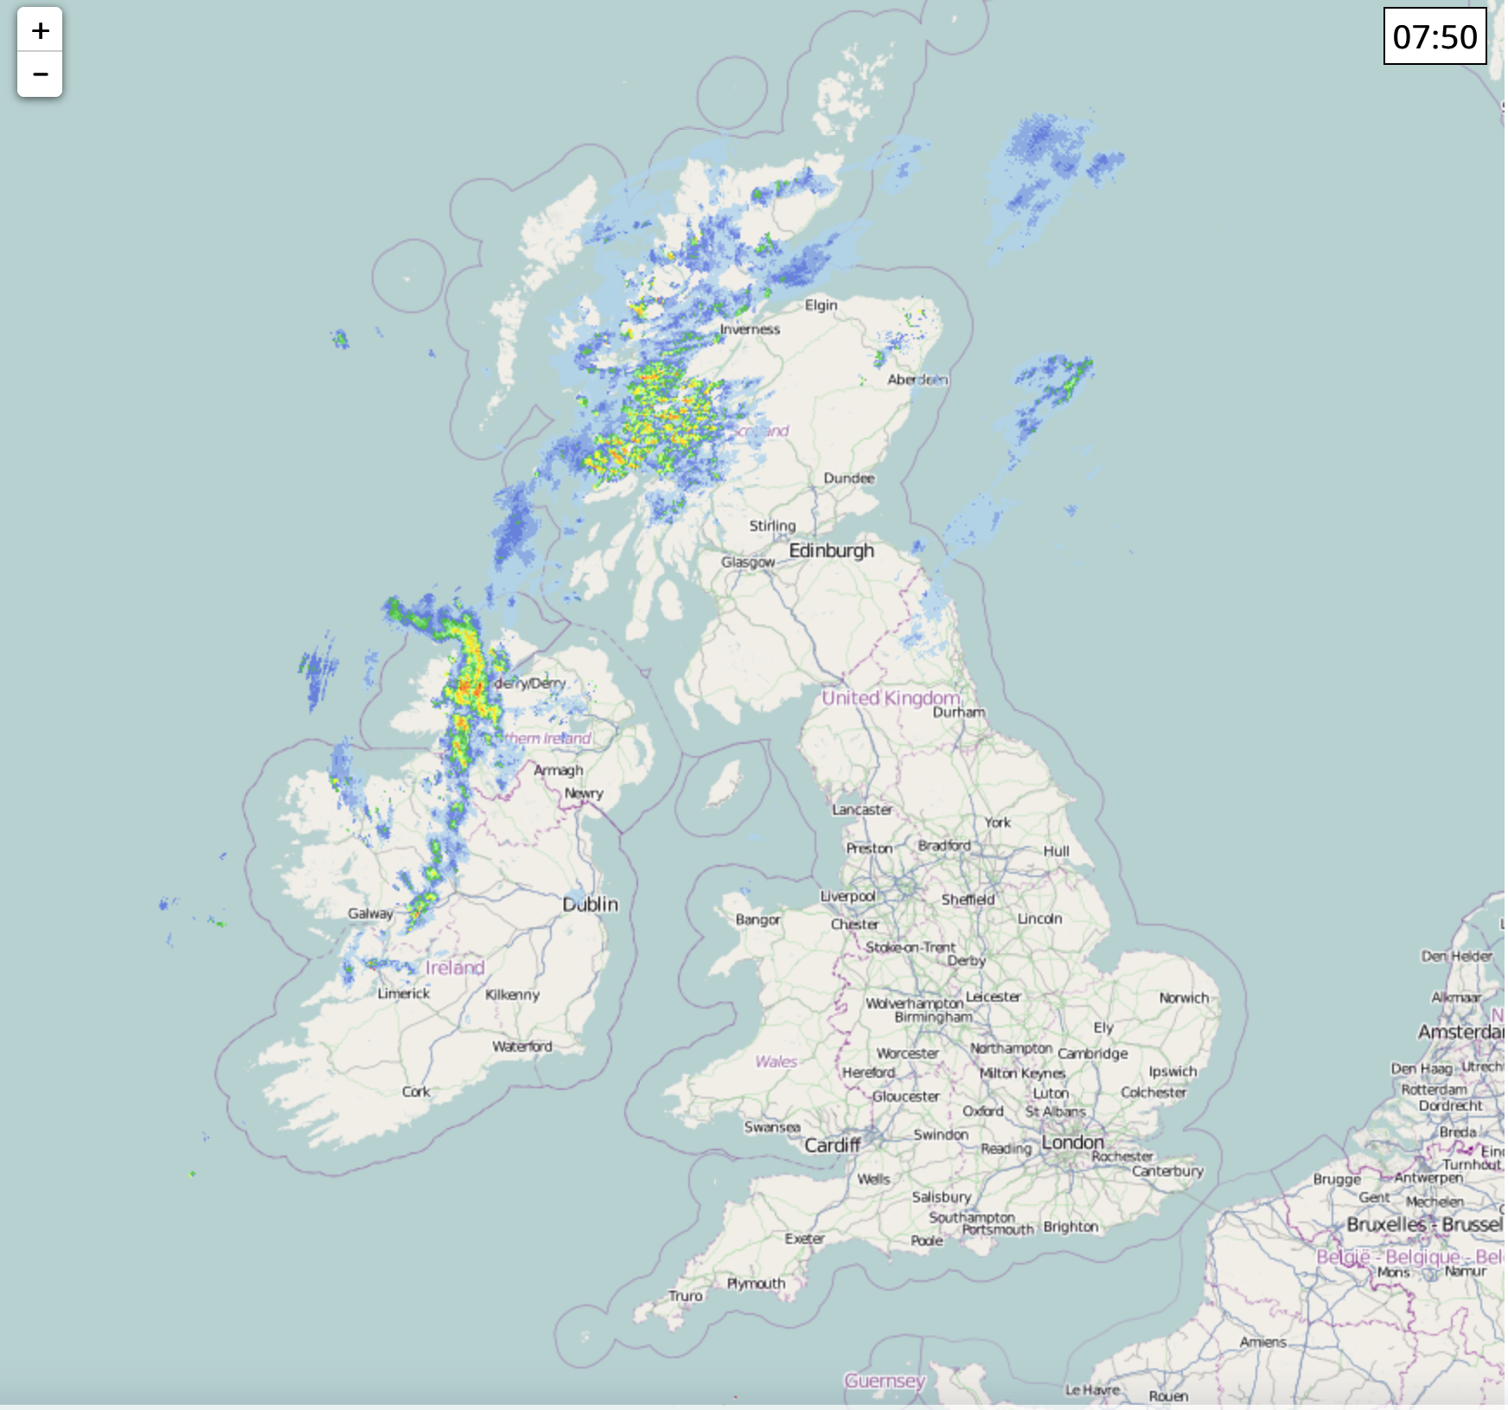
https://www.netweather.tv/live-weather/radar

Slide 11
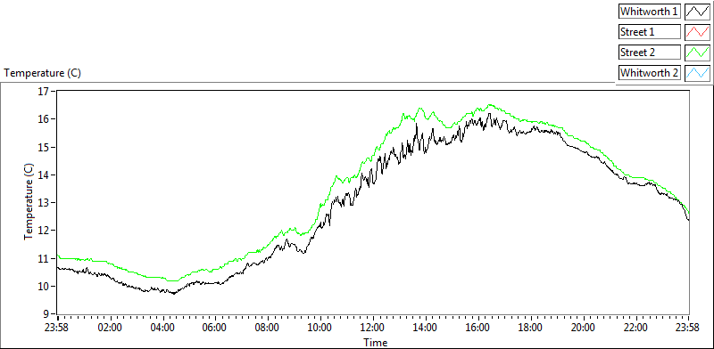
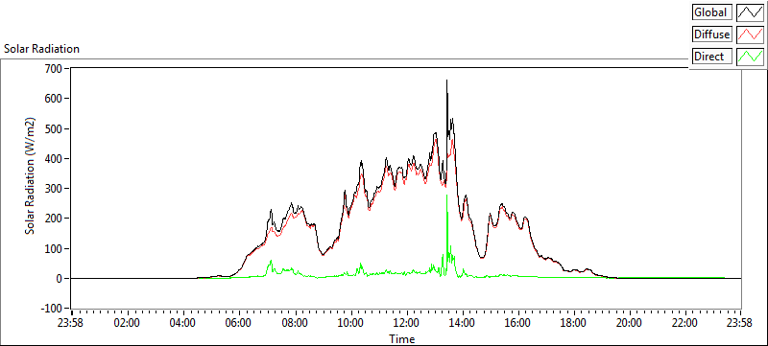
Whitworth
Observatory
Saturday
http://whitworth.cas.manchester.ac.uk/2025/04/26/

Slide 12
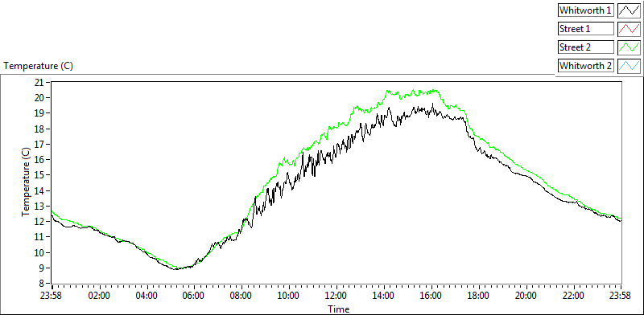
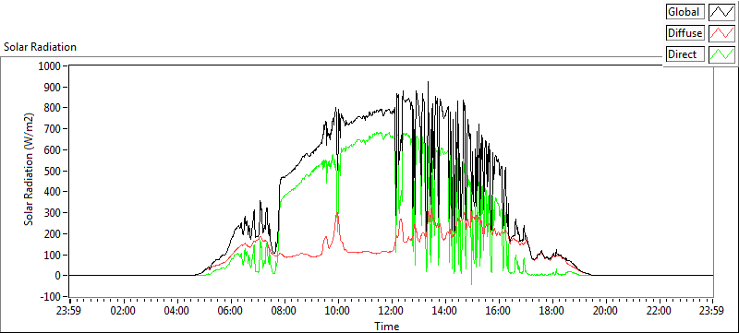
Whitworth
Observatory
Sunday
Closer to
a perfect
parabola and
higher values:
fewer clouds
http://www.cas.manchester.ac.uk/restools/whitworth/data/

Slide 13
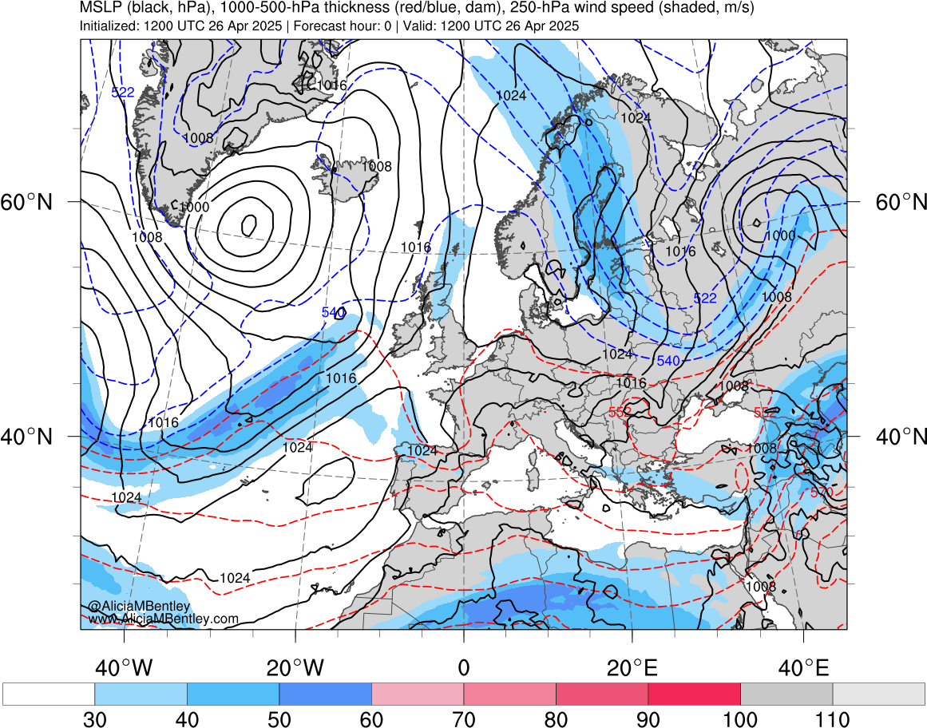
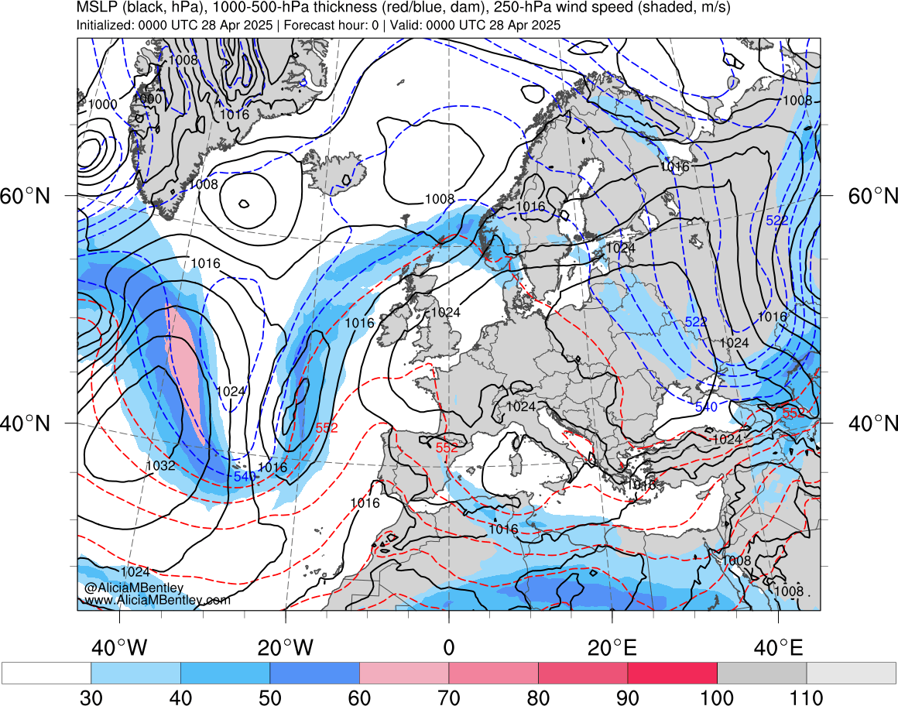
1200 UTC Saturday 26 April
0000 UTC Monday 28 April
Winds at 250-hPa (jet stream): colored shading
Sea-level pressure: black solid lines
https://www.atmos.albany.edu/student/abentley/realtime/standard.php?domain=europe&variable=mslp_jet

Slide 14
Sunday
1200 UTC Saturday 26 April
0000 UTC Monday 28 April
Winds at 250-hPa (jet stream): colored shading
Sea-level pressure: black solid lines
Jet stream has moved poleward, bringing warmer, less-cloudy air
https://www.atmos.albany.edu/student/abentley/realtime/standard.php?domain=europe&variable=mslp_jet

Slide 15
Animation of the jet stream:
Past, present, and future
https://www.atmos.albany.edu/student/abentley/realtime/standard.php?domain=europe&variable=mslp_jet

Slide 16
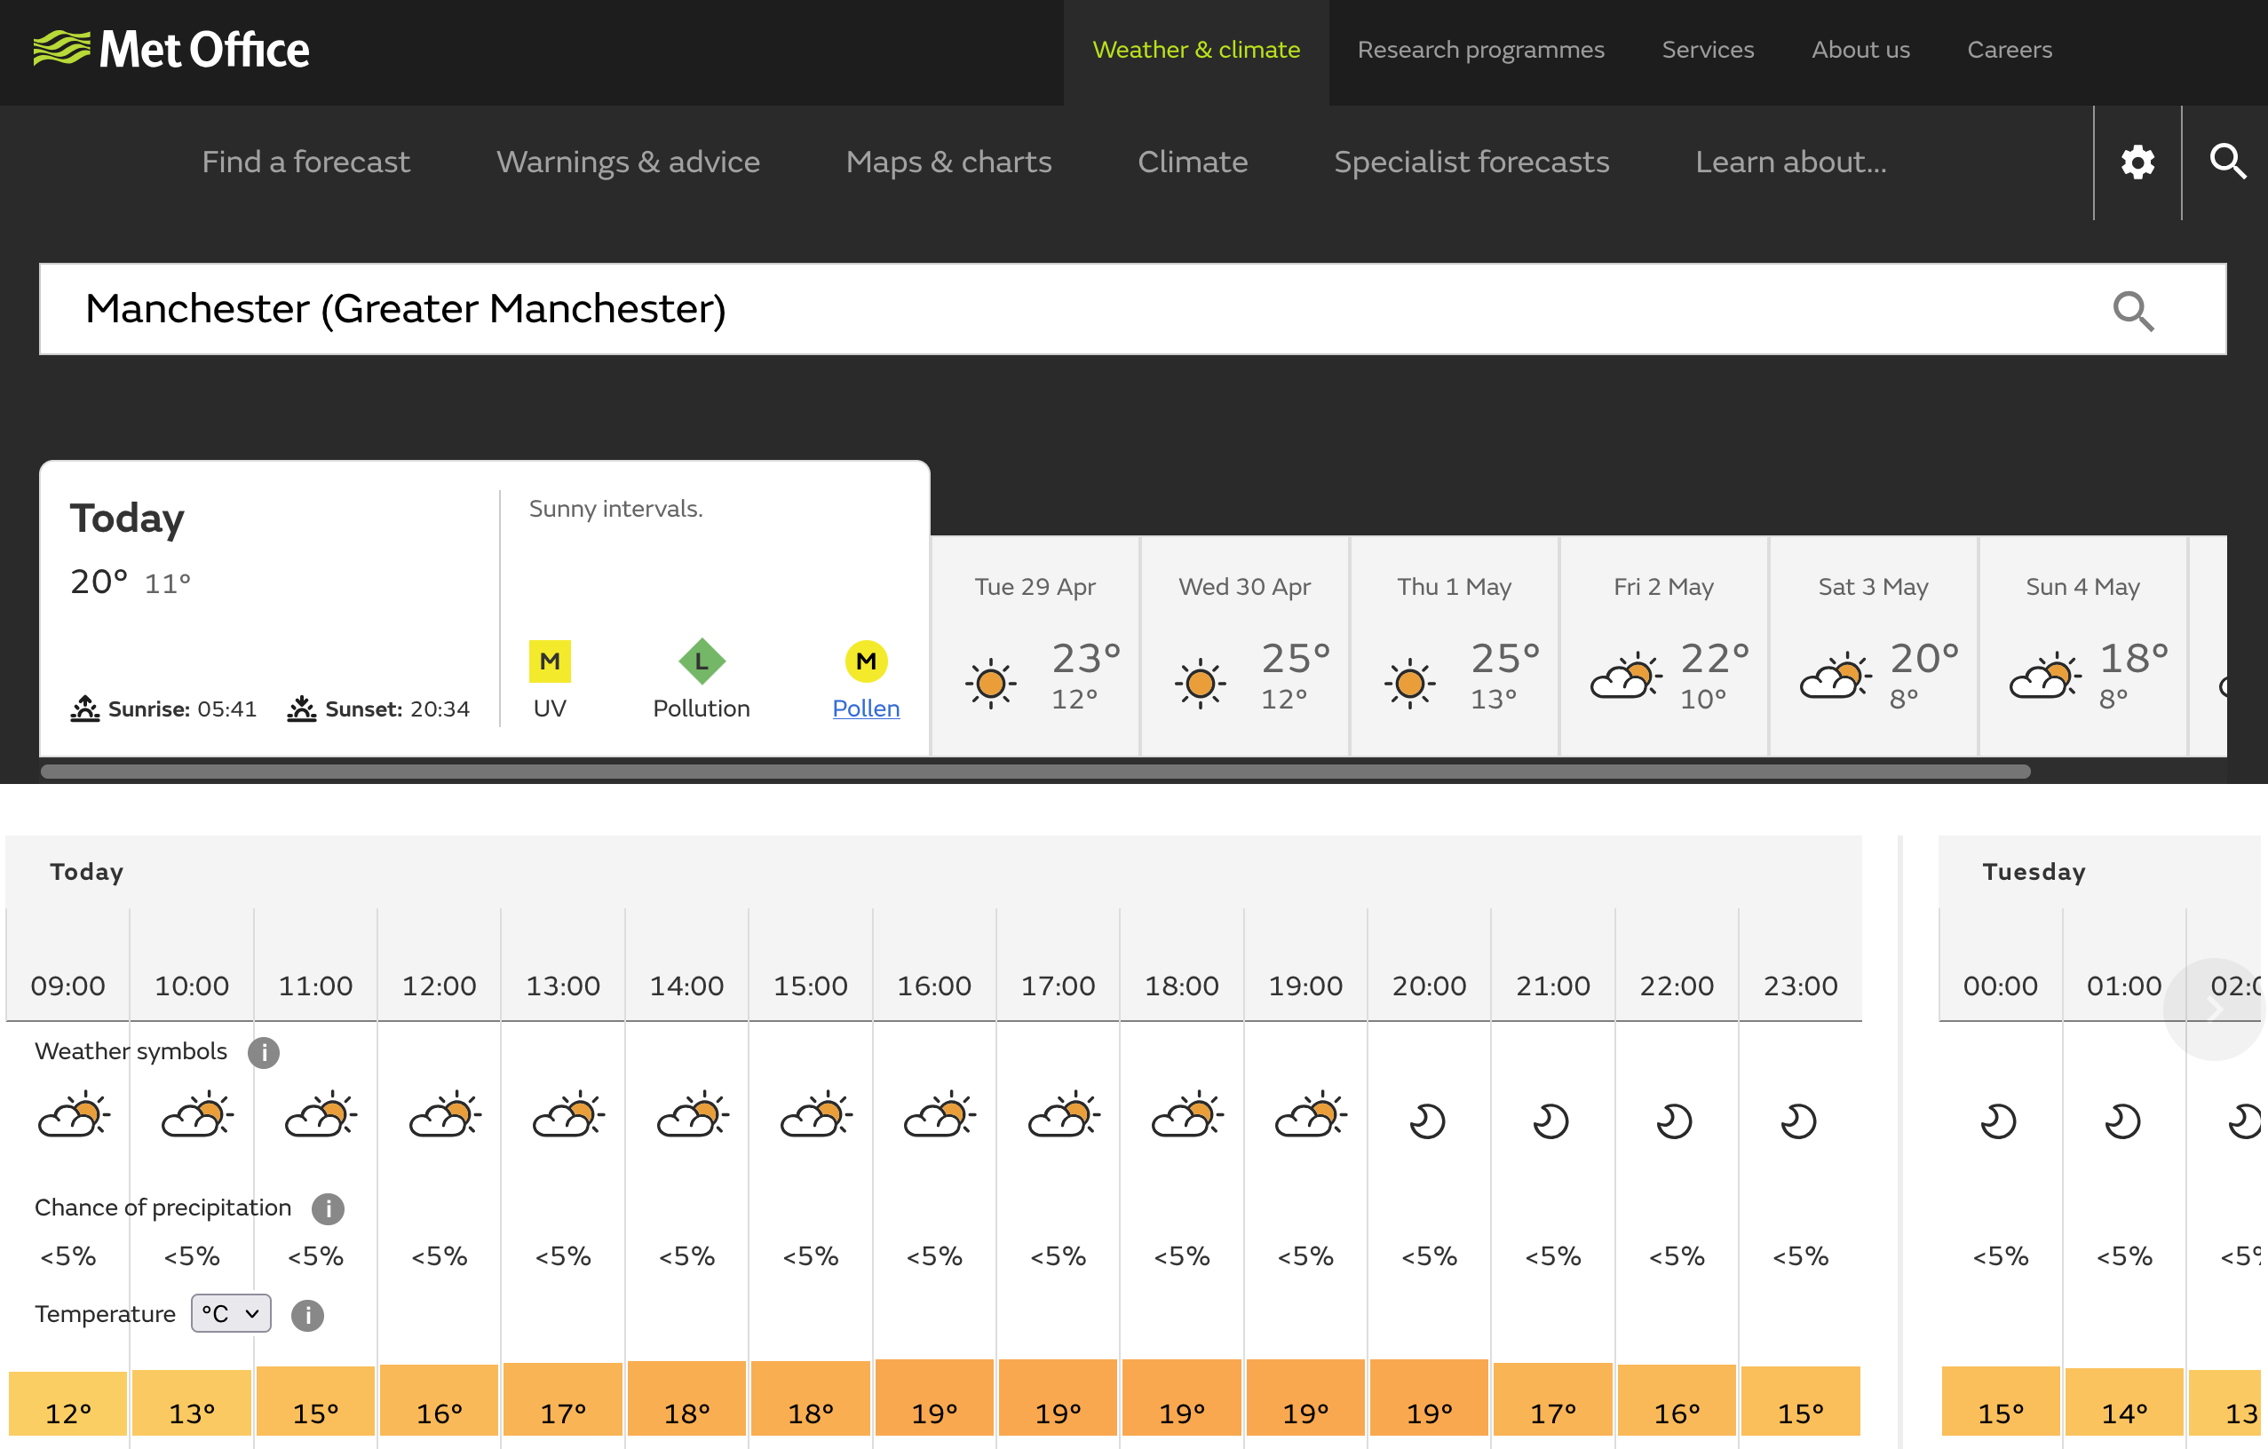

Slide 17

Feedbacks in Earth’s Climate System
A look at the variety of interactions within the climate system
What it means for doing field research

Slide 18
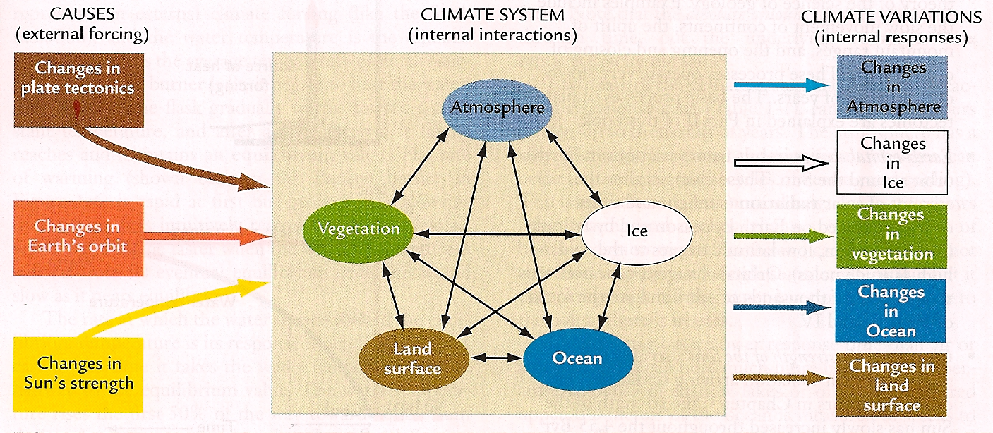
Cause and Effect = Forcing and Response
(Ruddiman 2008: Earth’s Climate: Past and Future)

Slide 19
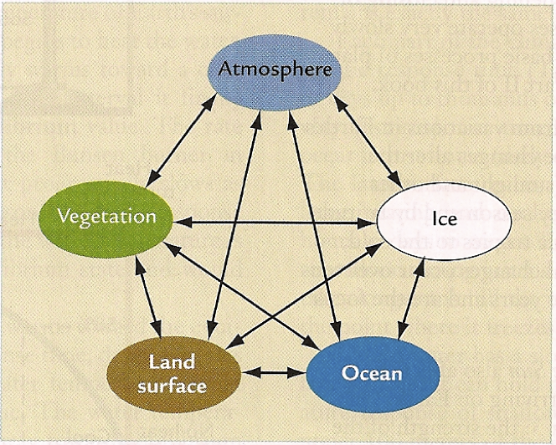

Slide 20
Example 1

Slide 21
Weathering of silicates removes carbon
dioxide from the atmosphere.
silicate mineral + CO₂ + H₂O → cations + HCO₃– + SiO₂
Notes:
An example of such a reaction is the weathering of wollastonite:
CaSiO₃ + 2CO₂ + H₂O → Ca²⁺ + SiO₂ + 2HCO₃⁻

Slide 22
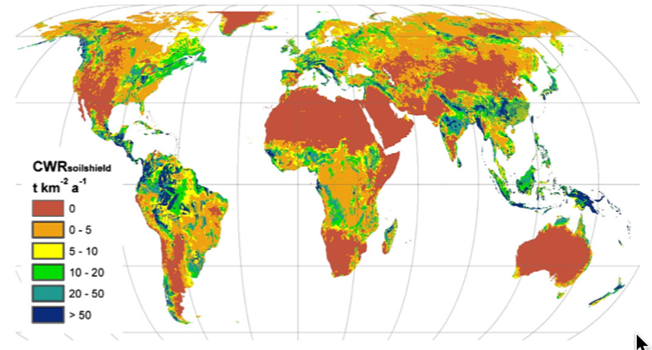
Calculated chemical weathering rates
http://dx.doi.org/10.1016/j.chemgeo.2013.10.025

Slide 23
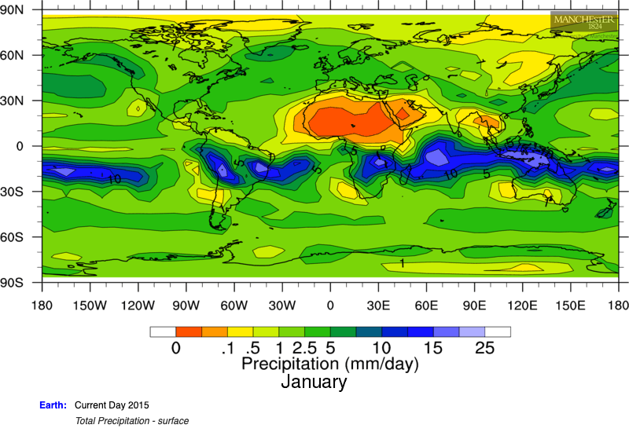
modeled precipitation
http://dx.doi.org/10.1016/j.chemgeo.2013.10.025

Slide 24
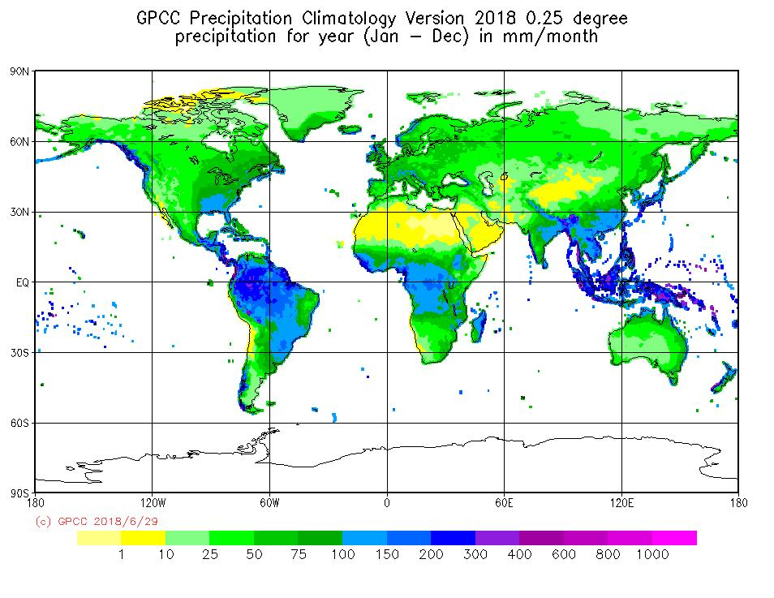
“observed” precipitation
http://dx.doi.org/10.1016/j.chemgeo.2013.10.025

Slide 25
Example 2
Ice–Albedo Feedback

Slide 26
Higher temperature ➔
Less polar ice ➔
Lower albedo (reflectivity of planet) ➔
More absorbed solar radiation ➔
Higher temperature

Slide 27
Example 3
The Glacial Buzzsaw

Slide 28
The Glacial Buzzsaw
Glaciers erode mountain peaks.
Mountains undergoing active orogeny are inhibited from rising much above the elevation of permanent glaciation, leaving just glaciated peaks.

Slide 29

The Glacial Buzzsaw

Slide 30
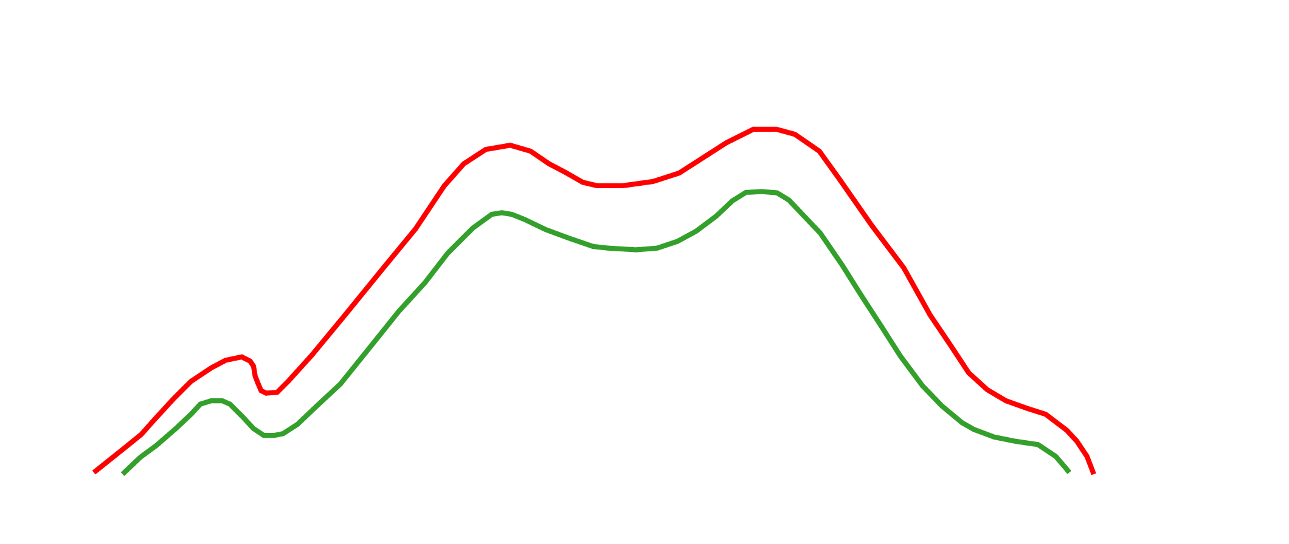
Broecker and Denton, 1990
Broecker and Denton, 1990

Slide 31
Limitation of the Glacial Buzzsaw
Glaciers that are frozen to the bedrock protect mountains from erosion more than they erode them (e.g., Patagonia, Antarctica, Alaska).
➔ Why glacial buzzsaw relationship breaks down at higher latitudes
(Thomson et al. 2010, doi:10.1038/nature09365)

Slide 32
Example 4

Slide 33
The break-up of the supercontinent Rodinia at 750 Ma led to an increase in weathering and runoff, reducing the amount of carbon dioxide in the atmosphere, leading to the Sturtian Snowball Earth…. but only because there was a flood basalt in the tropics.

Slide 34
Method:
Coupled climate–geochemical model GEOCLIM
(essentially, FOAM + long-term global carbon-cycle model)

Slide 35
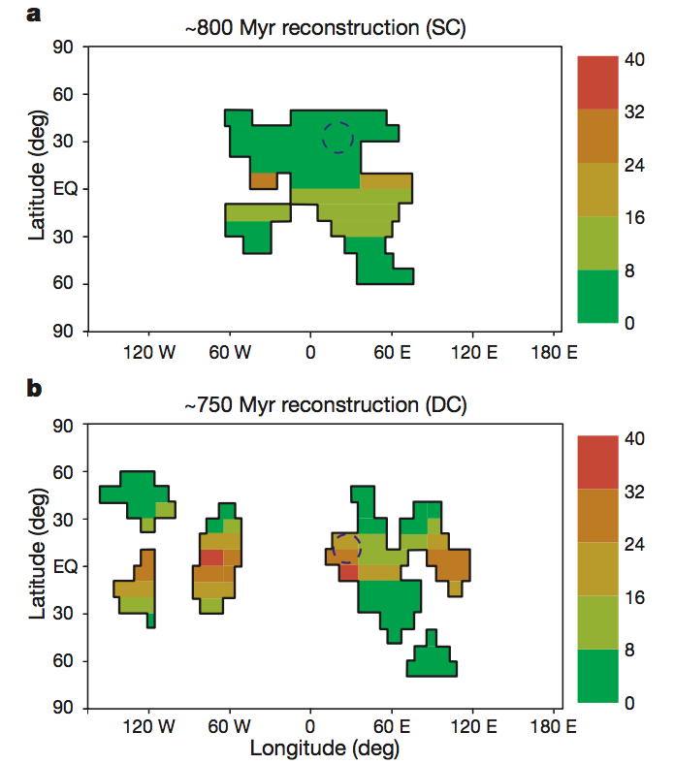
Weathering rates
(10⁴ mol km^{–2} yr^{–1})
lots of tropical and subtropical land
Supercontinent
Configuration
CONTROLLED
EXPERIMENT
Dispersed
Configuration
(Donnadieu et al. 2004, Nature)

Slide 36
Weathering rates
(10⁴ mol km^{–2} yr^{–1})
Supercontinent
Configuration
p_{CO2} =1830 ppm
Dispersed
Configuration
p_{CO2} =510 ppm
8°C colder
(Donnadieu et al. 2004, Nature)

Slide 37
Weathering rates
(10⁴ mol km^{–2} yr^{–1})
Supercontinent
Configuration
p_{CO2} about 1500 ppm
flood basalt
Dispersed
Configuration
p_{CO2} <250 ppm
SNOWBALL EARTH
(Donnadieu et al. 2004, Nature)

Slide 38
Example 5

Slide 39
The difference in temperature between the poles and the equator determines the ocean circulation and sedimentary environment.

Slide 40
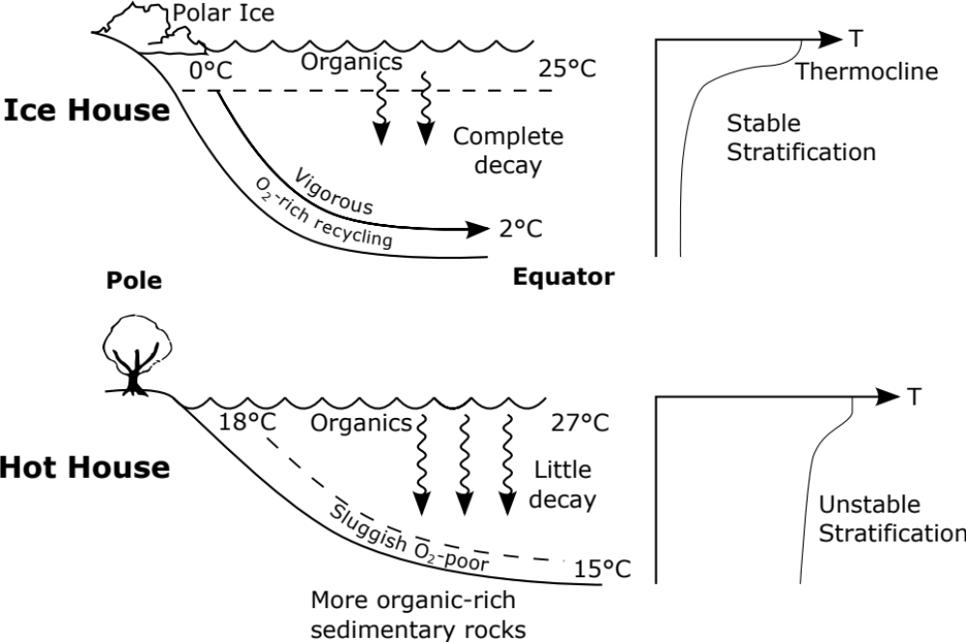
strong gradient in temperature between poles and equator
Present

Slide 41
strong gradient in temperature between poles and equator
marine snow
Present
marine snow
Cretaceous
weak gradient in temperature between poles and equator

Slide 42
Present
Cretaceous
ocean anoxic events
black shales

Slide 43
Implications for Global Climate-Scale Thinking for Field Geological Studies

Slide 44
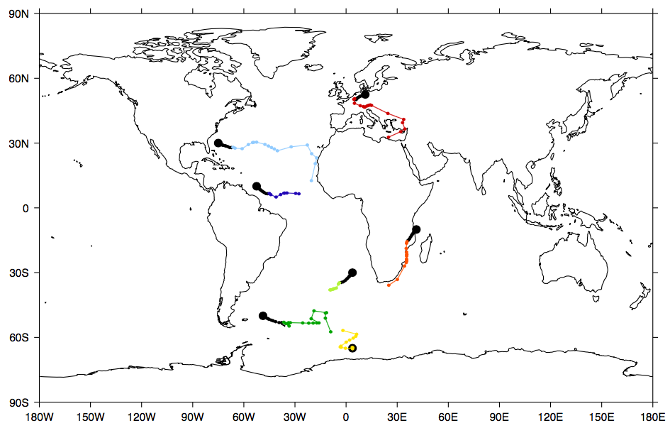
Present
34 Ma
146 Ma
(Lunt et al. 2016, Clim. Past)

Slide 45
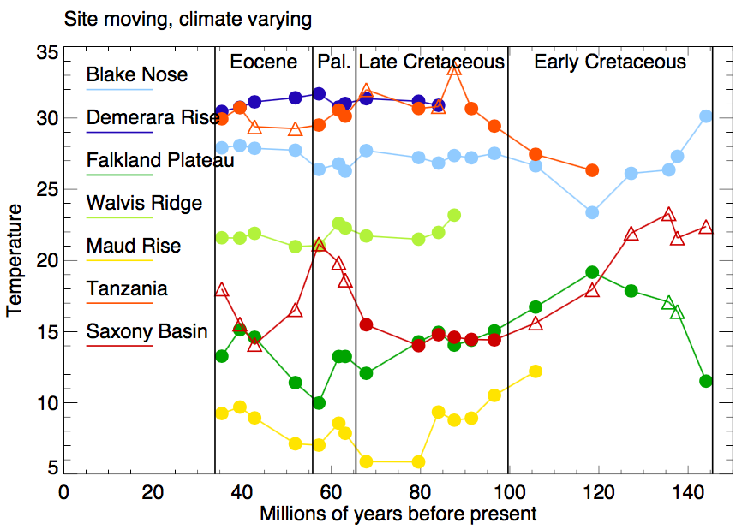
(Lunt et al. 2016, Clim. Past)

Slide 46
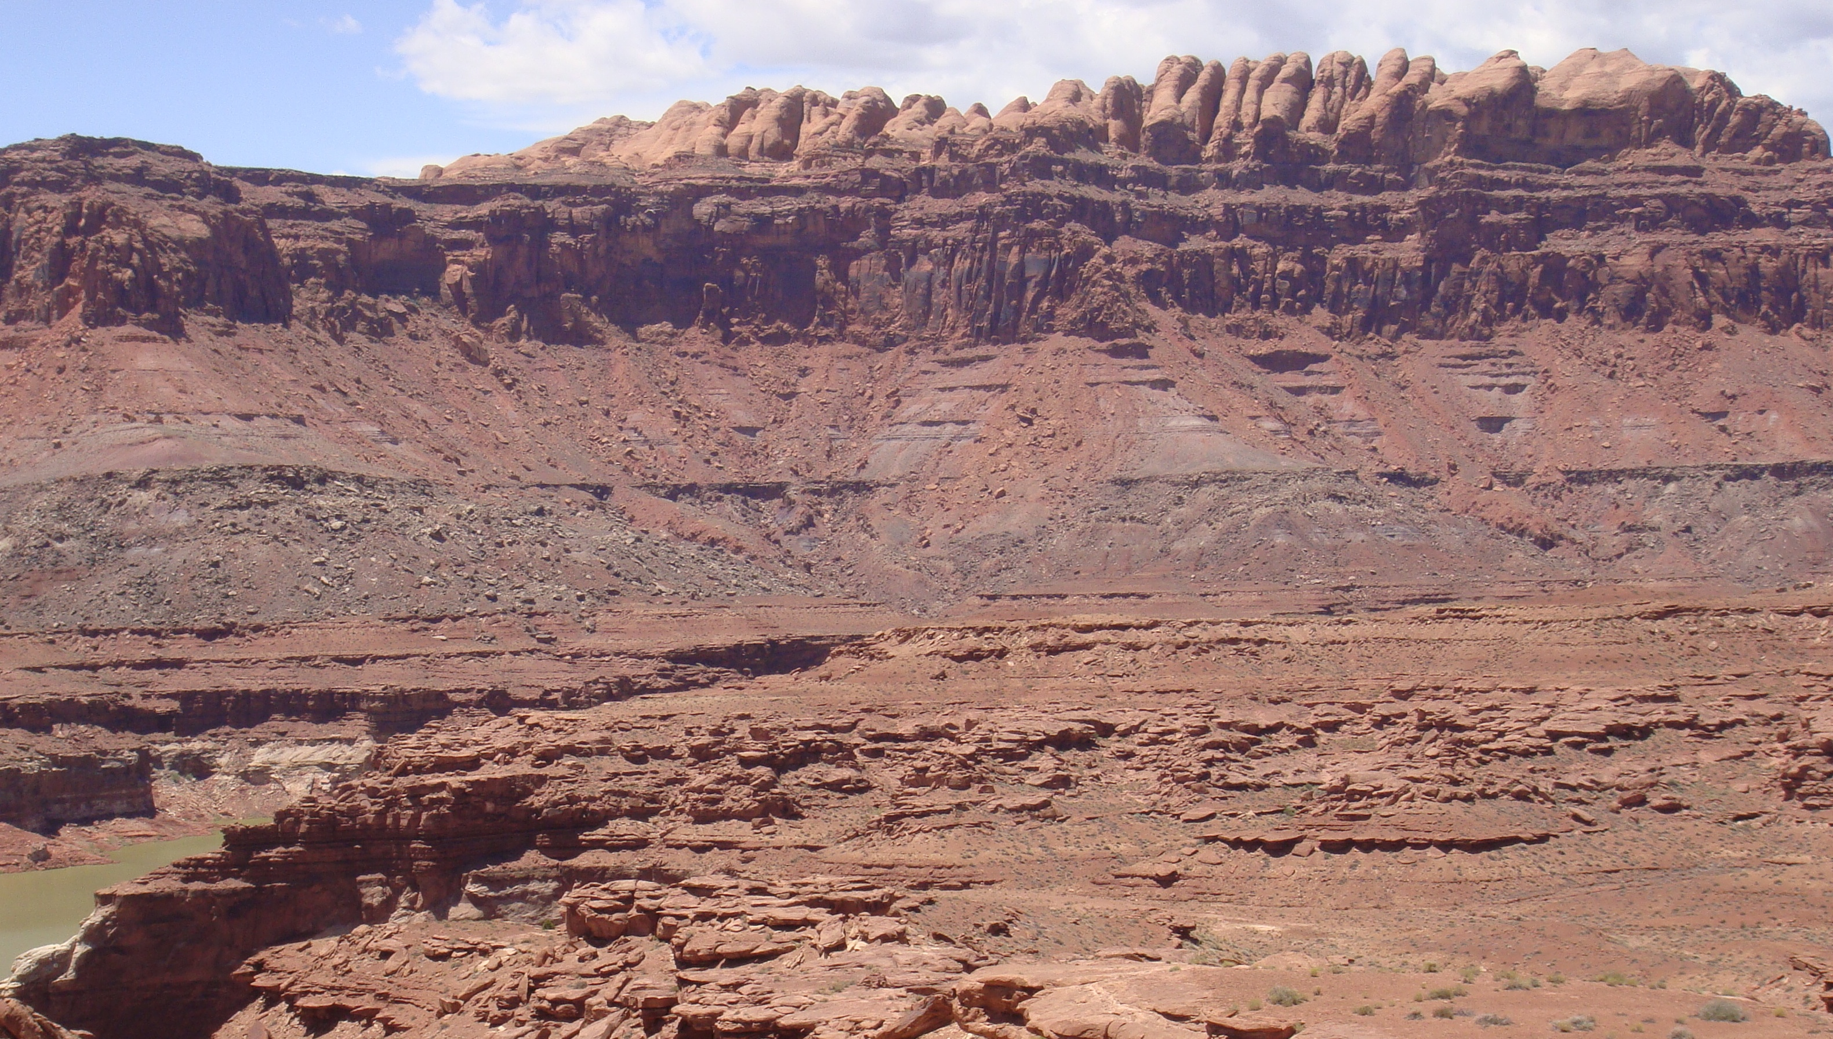
Your field site
Notes:
https://commons.wikimedia.org/wiki/File:SEUtahStrat.JPG
The Permian (bottom) through Jurassic (top) stratigraphy of the Colorado Plateau area of southeastern Utah that makes up much of the famous prominent rock formations in protected areas such as Capitol Reef National Park and Canyonlands National Park. From top to bottom: Rounded tan domes of the Navajo Sandstone, layered red Kayenta Formation, cliff-forming, vertically-jointed, red Wingate Sandstone, slope-forming, purplish Chinle Formation, layered, lighter-red Moenkopi Formation, and white, layered Cutler Formation sandstone. Picture from Glen Canyon National Recreation Area, Utah.

Slide 47
Your field site
aeolian sandstone
braided-river sediments
Notes:
https://commons.wikimedia.org/wiki/File:SEUtahStrat.JPG
The Permian (bottom) through Jurassic (top) stratigraphy of the Colorado Plateau area of southeastern Utah that makes up much of the famous prominent rock formations in protected areas such as Capitol Reef National Park and Canyonlands National Park. From top to bottom: Rounded tan domes of the Navajo Sandstone, layered red Kayenta Formation, cliff-forming, vertically-jointed, red Wingate Sandstone, slope-forming, purplish Chinle Formation, layered, lighter-red Moenkopi Formation, and white, layered Cutler Formation sandstone. Picture from Glen Canyon National Recreation Area, Utah.

Slide 48
How do you know that the climate changed or the paleolocation changed?
aeolian sandstone
braided-river sediments

Slide 49
Summary
Climate feedbacks help us understand the interactions between the different climate components.
Glacial buzzsaw limits the growth of mountains.
Weathering of silicates removes carbon dioxide from the atmosphere.
Hot-house climates limit the decay of organic material in ocean.
Be careful interpreting single-site changes in climate in your fieldwork.

Slide 50
Anthropogenic climate change affects all five components of the climate system.

Slide 51
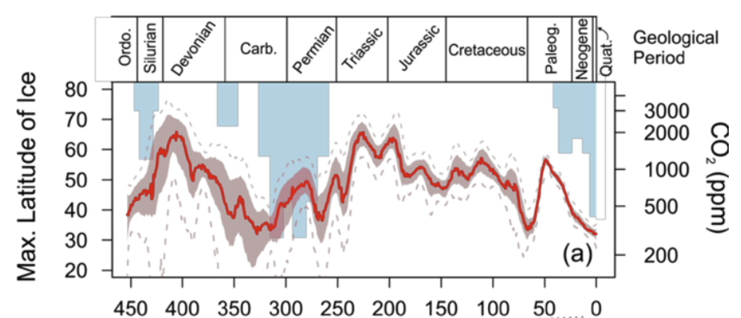
Lear et al. (2020)
Notes:
Fig. 1. Carbon dioxide and climate through the Phanerozoic. (a) Latitudinal extent of continental ice deposits (Crowley 1998) shown as blue bars (left axis) and atmospheric CO2 content (red, right axis) from the compilation of Foster et al. (2017) augmented with the data from Witkowski et al. (2018). The dotted line shows the 95% confidence interval and the shaded band the 68% confidence interval. Note the close correspondence between extensive continental glaciation (i.e. cold icehouse climates) and intervals of low CO2 content (e.g. the Carboniferous), and times of no or limited continental ice (i.e. warm greenhouse climates) with elevated CO2 (e.g. the Cretaceous). (b) A close-up of the last 0.8 million years comparing CO2 from ice cores (red, right axis; Bereiter et al. 2015) with benthic foraminiferal oxygen isotope ratios (δ18O) (blue, left axis; from Lisiecki and Raymo 2005). Benthic foraminiferal δ18O reflects a combination of bottom water temperature and ice volume, cold glacial climates are towards the bottom of the diagram and warm interglacial intervals are at the top of the diagram. Again a close correspondence exists between cold intervals and low CO2 (and vice versa). In (b) the relatively rapid cycling between low CO2 glacials and high CO2 interglacials is paced by orbital forcing (Milankovitch cycles, see text and Box 2). The geological time intervals are shown on the top of panel (a). Abbreviations are as follows: Carb., Carboniferous; Ordo, Ordovician; Paleog, Paleogene; Quat., Quaternary.

Slide 52
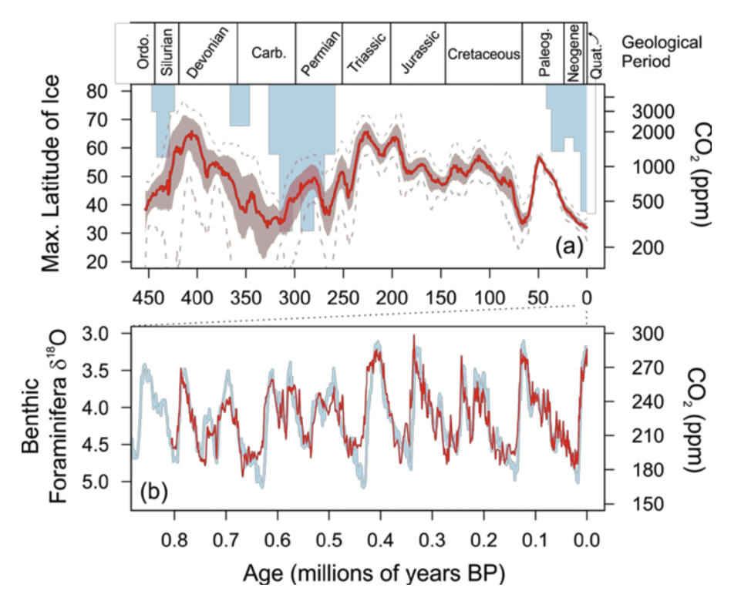
Lear et al. (2020)
Notes:
Fig. 1. Carbon dioxide and climate through the Phanerozoic. (a) Latitudinal extent of continental ice deposits (Crowley 1998) shown as blue bars (left axis) and atmospheric CO2 content (red, right axis) from the compilation of Foster et al. (2017) augmented with the data from Witkowski et al. (2018). The dotted line shows the 95% confidence interval and the shaded band the 68% confidence interval. Note the close correspondence between extensive continental glaciation (i.e. cold icehouse climates) and intervals of low CO2 content (e.g. the Carboniferous), and times of no or limited continental ice (i.e. warm greenhouse climates) with elevated CO2 (e.g. the Cretaceous). (b) A close-up of the last 0.8 million years comparing CO2 from ice cores (red, right axis; Bereiter et al. 2015) with benthic foraminiferal oxygen isotope ratios (δ18O) (blue, left axis; from Lisiecki and Raymo 2005). Benthic foraminiferal δ18O reflects a combination of bottom water temperature and ice volume, cold glacial climates are towards the bottom of the diagram and warm interglacial intervals are at the top of the diagram. Again a close correspondence exists between cold intervals and low CO2 (and vice versa). In (b) the relatively rapid cycling between low CO2 glacials and high CO2 interglacials is paced by orbital forcing (Milankovitch cycles, see text and Box 2). The geological time intervals are shown on the top of panel (a). Abbreviations are as follows: Carb., Carboniferous; Ordo, Ordovician; Paleog, Paleogene; Quat., Quaternary.

Slide 53
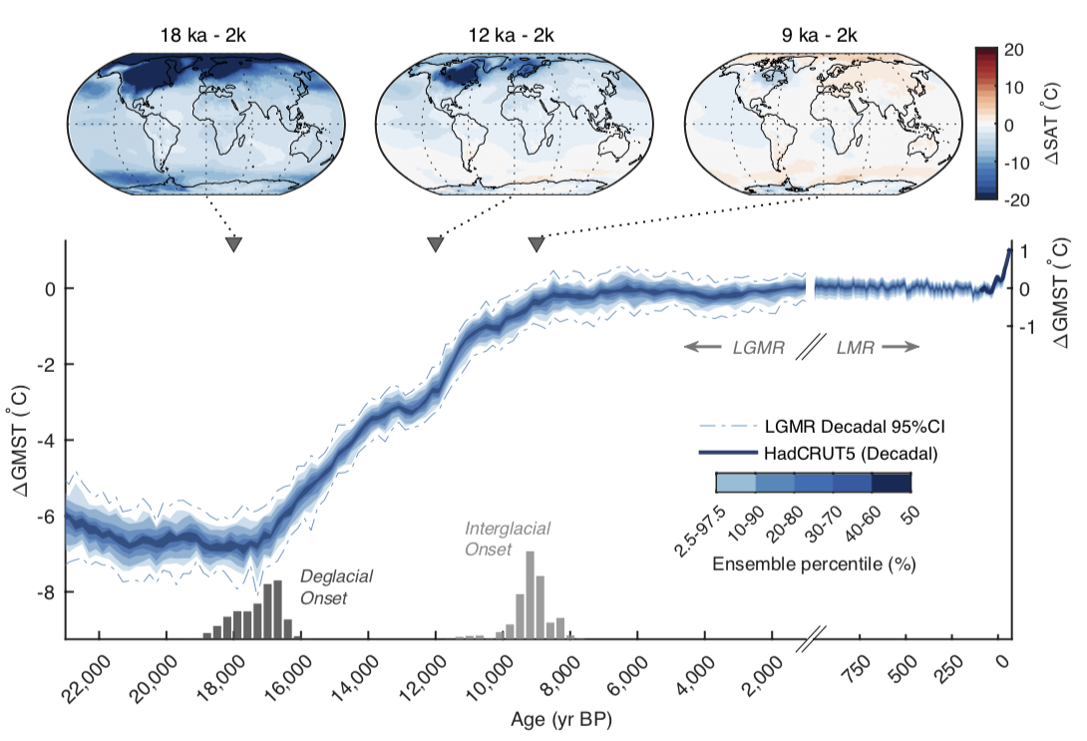
https://eartharxiv.org/repository/view/2219/
Notes:
Fig. 2. Global mean surface temperature change over the last 24 ka. Ensemble distribution (n = 300) of LGMR GMST for the past 24 ka (blue colors), with a decadal 95th-percentile range (dotted-dashed lines) estimated using time-evolving GMST decadal-to-centennial mean ratios from iCESM (Methods). Shown at top are corresponding spatial surface temperature anomalies for intervals discussed in the main text. The estimated last deglacial and interglacial onset timings are shown as dark and light histograms at bottom (Methods). Juxtaposed alongside the LGMR (right-hand side) are reconstructed decadal GMST’s from the Last Millennium Reanalysis v2.1 18 and HadCRUT5 observational product 11. ∆GMST is computed relative to the pre-industrial last millennium average (1000-1850 CE).

Slide 54
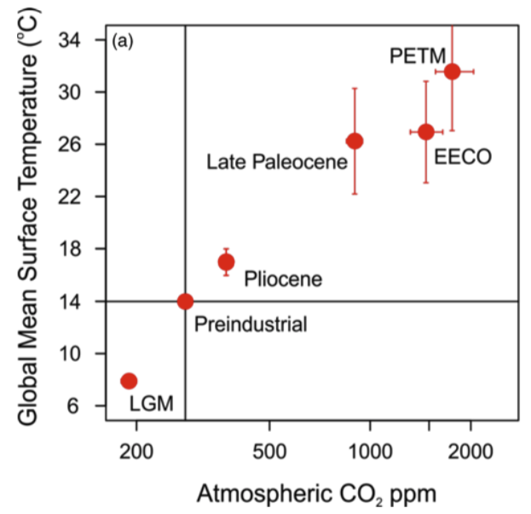
Lear et al. (2020)
Notes:
Fig. 2. (a) The relationship between atmospheric CO2 concentration and global mean surface temperature (GMST) for five time intervals where both variables have been recently well constrained by geological data (Anagnostou et al. 2020; de la Vega et al. 2020; Inglis et al. 2020; Sherwood et al. 2020; Tierney et al. 2020). Error bars reflect 68% confidence intervals and in some cases are smaller than the symbol. LGM, Last Glacial Maximum; EECO, Early Eocene Climatic Optimum; PETM, Paleocene–Eocene Thermal Maximum. (b) The relationship between radiative forcing (ΔR in W m−2) and global mean surface temperature (ΔGMST) relative to pre-industrial values. Contours show equilibrium climate sensitivity from 1 to 10°C per CO2 doubling, and the blue band shows the canonical IPCC range of Equilibrium Climate Sensitivity of 1.5 to 4.5°C per CO2 doubling. Note that data in panel (b) are corrected for slow feedbacks (see text) following the methods detailed in Tierney et al. (2020) and Inglis et al. (2020).

Slide 55
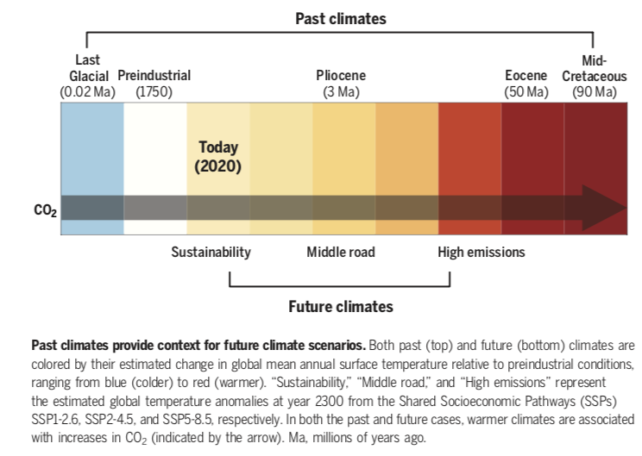
https://doi.org/10.1126/science.aay3701

Slide 56
Cause and Effect = Forcing and Response
(Ruddiman 2008: Earth’s Climate: Past and Future)

Slide 57
Cause and Effect = Forcing and Response
Anthropogenic
forcing
(Ruddiman 2008: Earth’s Climate: Past and Future)

Slide 58
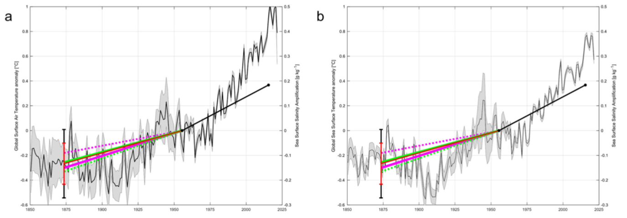
Climate change affects the atmosphere and hydrosphere.
Surface Air Temperature
Sea Surface Temperature
surface ocean salinity
surface ocean salinity
1850
1900
1950
2000
1850
1900
1950
2000
Surface ocean salinity changes from round-the-world voyages
of HMS Challenger and SMS Gazelle in the 1870s compared
with Surface Air Temperature and Sea Surface Temperature
https://doi.org/10.1038/s43247-021-00161-3
Notes:
Fig. 3 Surface salinity changes since the 1870s compared with Surface Air Temperature (SAT) and Sea Surface Temperature (SST). Surface salinity (SSS) changes compared with changes in a, HadCRUT Surface Air Temperature (SAT) and b, HadSST Sea Surface Temperature (SST). Both data sets have been adjusted so that the average temperature anomaly for the period (1950–1959) is zero. The solid black line from 1954 to 2014 is the mean EN4 salinity change (2010–2019)-(1950–1959) between positive and negative salinity anomaly regions of 0.184 g kg−1. The salinity change pre-1950s is determined from the comparison of the Challenger and Gazelle data to both EN4 and CZ16 data. The error bars are derived from the 95% confidence limits. Magenta solid CH(EN4), magenta dashed GZ(EN4), green solid CH(CZ16) and green dashed GZ(CZ16). The solid red is the mean of the slope and error from the four analyses.

Slide 59
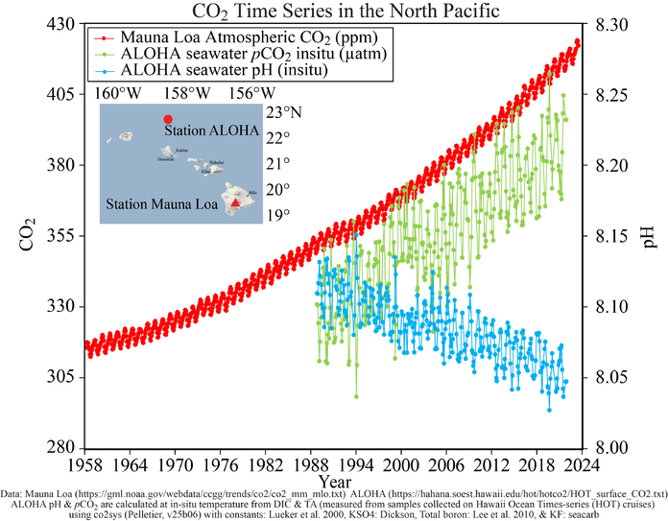
Climate change affects the atmosphere and hydrosphere.
https://www.pmel.noaa.gov/co2/file/Hawaii%20Carbon%20Dioxide%20Time-Series
Notes:
A similar graph from satellite data from the European Space Agency is here:
https://www.esa.int/ESA_Multimedia/Images/2024/02/Global_ocean_acidification_increase.

Slide 60
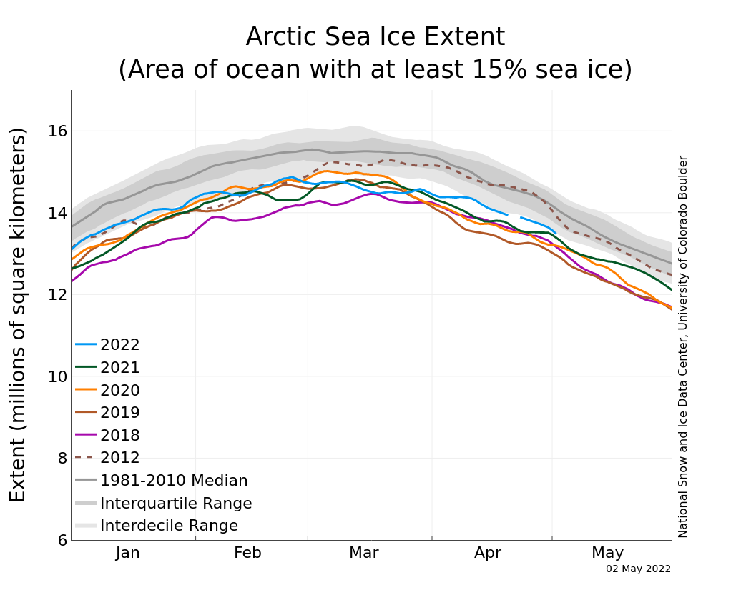
Climate change affects the cryosphere.
Notes:
https://nsidc.org/arcticseaicenews/
Figure 2a. The graph above shows Arctic sea ice extent as of May 2, 2022, along with daily ice extent data for four previous years and the record low year. 2022 is shown in blue, 2021 in green, 2020 in orange, 2019 in brown, 2018 in magenta, and 2012 in dashed brown. The 1981 to 2010 median is in dark gray. The gray areas around the median line show the interquartile and interdecile ranges of the data. Sea Ice Index data.
Credit: National Snow and Ice Data Center

Slide 61
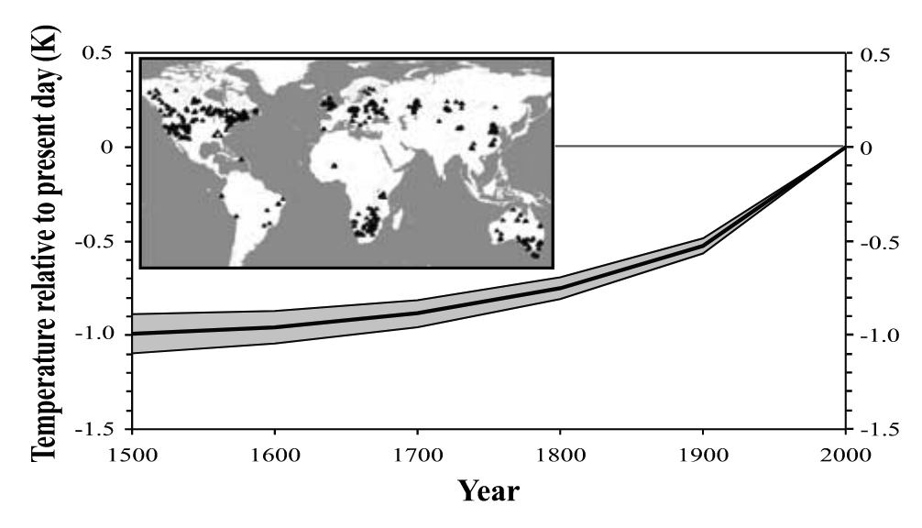
Climate change affects the lithosphere.
ground surface temperatures, calculated as histories from borehole temperatures
Geophysical Research Letters, Volume: 29, Issue: 8, Pages: 8-1-8-3, First published: 17 April 2002, DOI: (10.1029/2001GL014310)
Notes:
Global average of ground surface temperature histories (GSTH) over the past five centuries. Shaded areas represent ±1 standard error about the mean. Inset shows the location of the 616 bore holes where subsurface temperature measurements have been analyzed to reconstruct the global GSTH. https://agupubs.onlinelibrary.wiley.com/doi/10.1029/2001GL014310

Slide 62
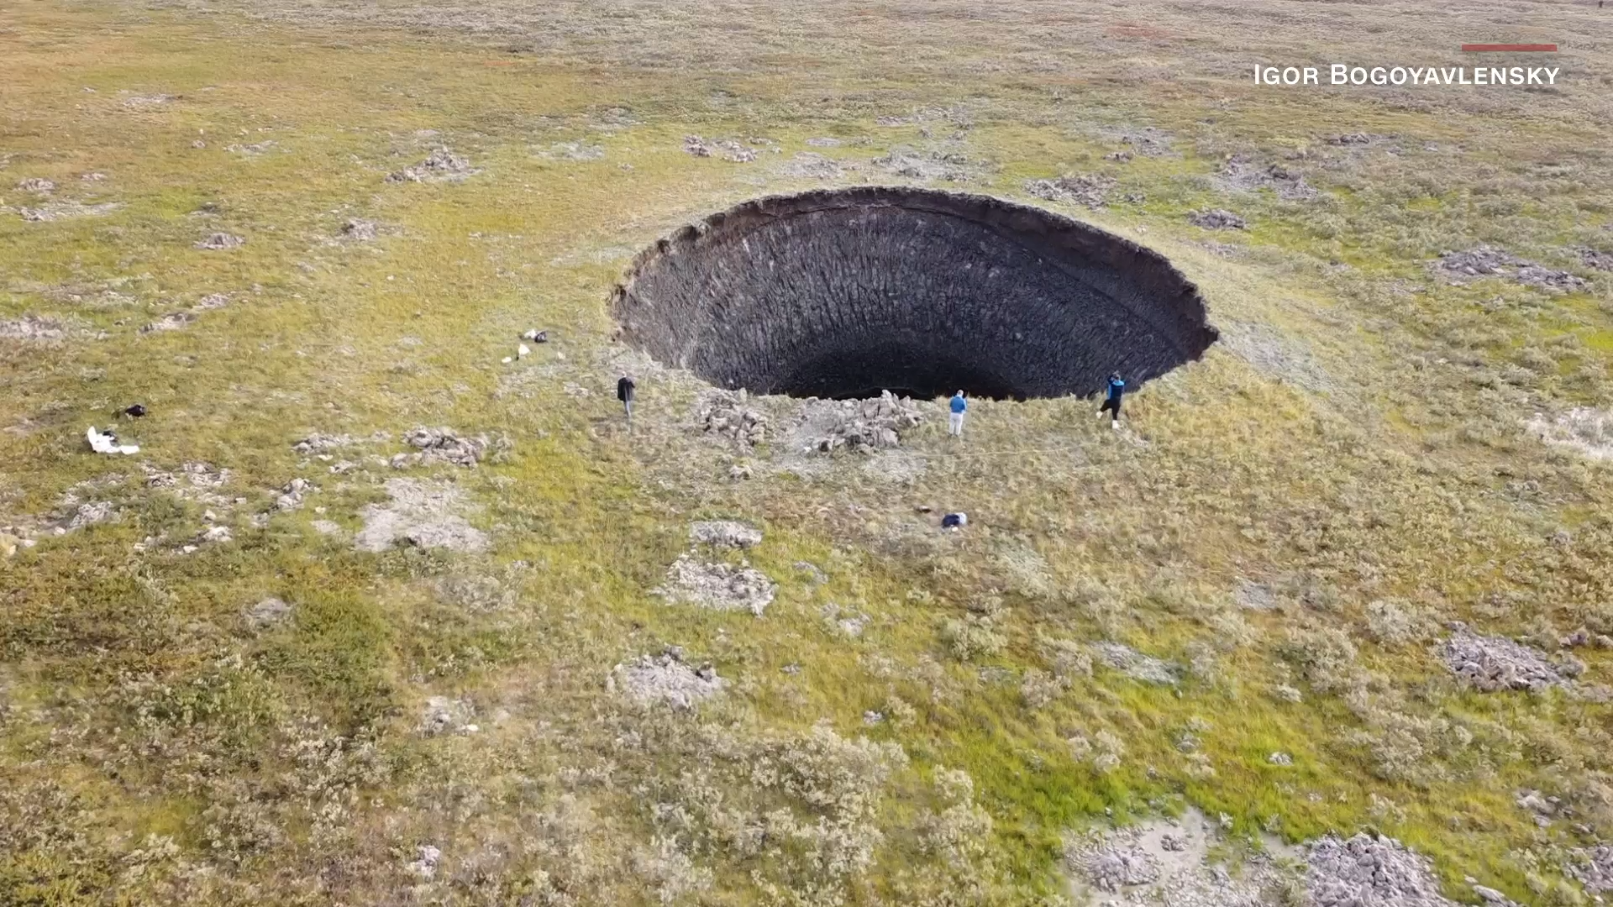
Climate change affects the lithosphere and atmosphere.
“The accumulation of gas, the pressure rise and the development of gas-dynamic processes in the cavity led to the growth
of the perennial heaving mound, and the explosion and formation of the crater.”
See also https://www.mdpi.com/2076-3263/11/2/71#
Notes:
See also: https://www.mdpi.com/2076-3263/11/2/71#

Slide 63
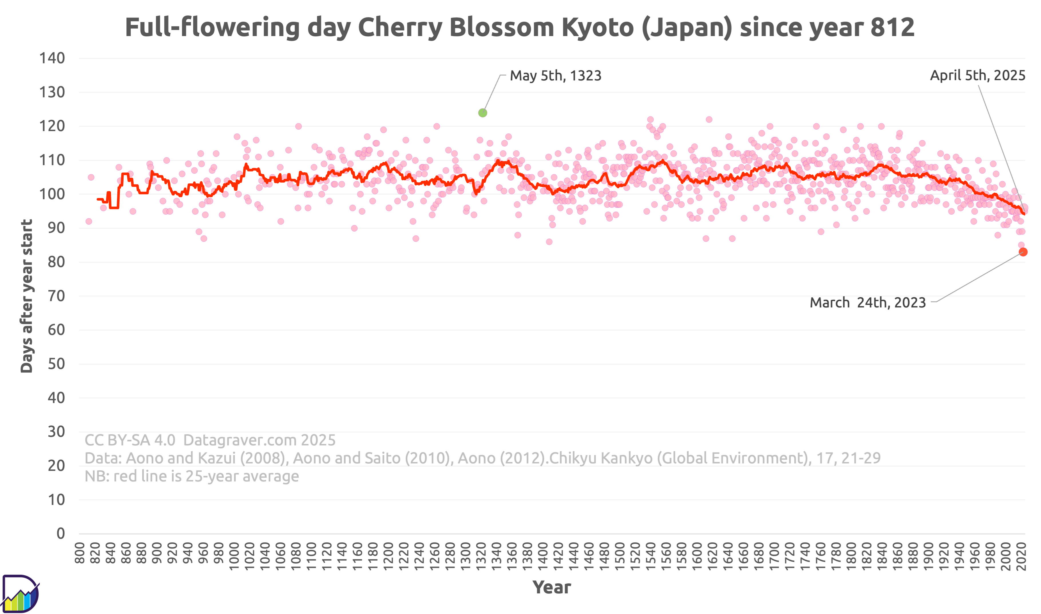
Climate change affects the biosphere.
https://datagraver.com/kyoto-full-flowering-day-cherry-blossom-since-year-812/

Slide 64
Climate change affects the biosphere.
https://datagraver.com/kyoto-full-flowering-day-cherry-blossom-since-year-812/

Slide 65
Cause and Effect = Forcing and Response
Anthropogenic
forcing
(Ruddiman 2008: Earth’s Climate: Past and Future)

Slide 66
Cause and Effect = Forcing and Response
Anthropogenic
forcing
(Ruddiman 2008: Earth’s Climate: Past and Future)

Slide 67
Although the Earth has undergone large changes over geologic time, the patterns of moist tropics and dry subtropics with polar jet streams are relatively consistent.
Details about these features change and their locations may shift slightly on the planet, but the planetary-scale circulation (Hadley cells, polar jet streams) is a consistent feature throughout geologic time.

Slide 68
Thought-Provoking Question
Consider a hypothetical distribution of land, oceans, and mountains on the Earth. Map out the associated climate patterns (winds, temperature, precipitation), ocean circulation (currents, temperature, salinity), vegetation, sedimentary record, etc. Justify your map.

Slide 69
0945–1145 Wednesday 4 June
Nancy Rothwell CL 4 & 5
Final Exam
Read:
Blackboard > Assessment & Feedback >
Information about the Assessment in A Dynamic Planet

Slide 70
On your computer’s or phone’s web browser, go to
kahoot.it
You can download the kahoot app or bookmark the website for future lectures.

